Slide 1


EVENT TICKETING DAPP
PRASAMSA KONDAPANENI
16353881

Slide 2
OBJECTIVE:
To create a decentralized application that allows users to mint, buy, sell, and verify event tickets as NFTs on the blockchain, ensuring transparency, authenticity, and ease of use.

Slide 3
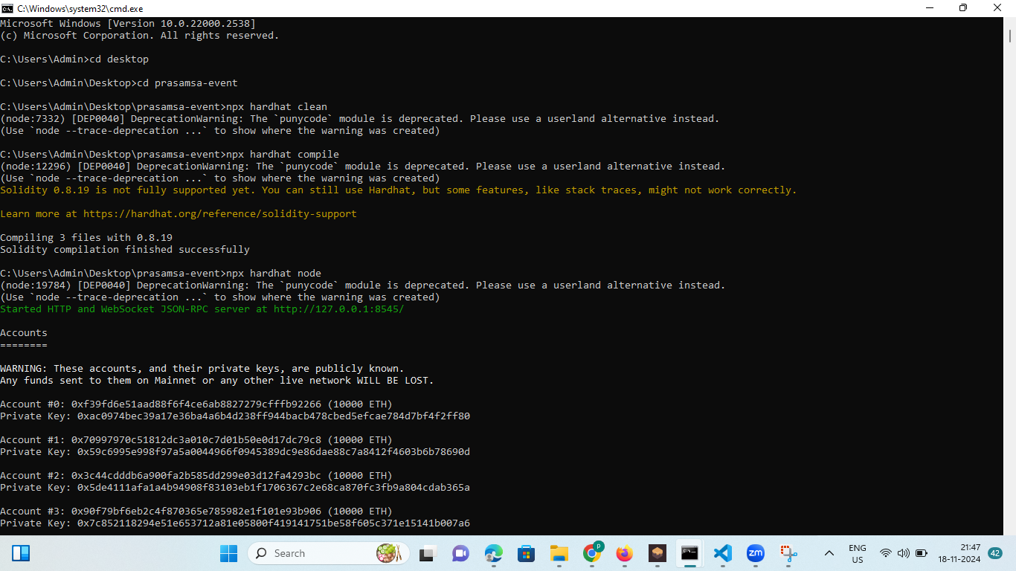

Slide 4
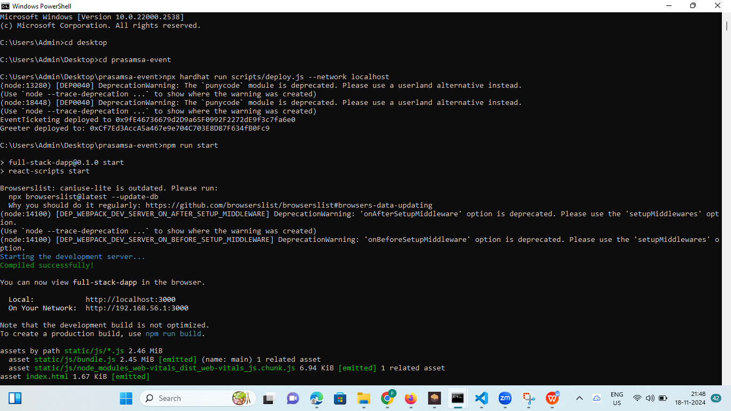

Slide 5
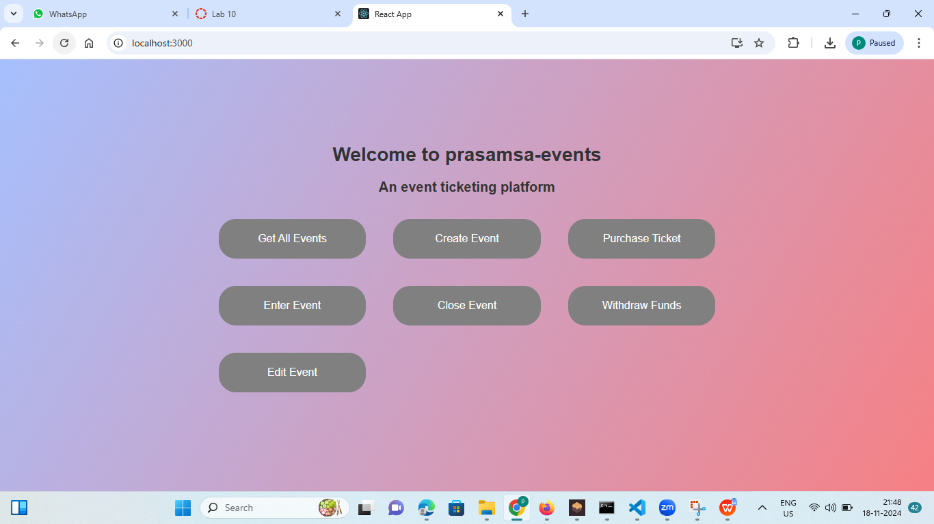

Slide 6
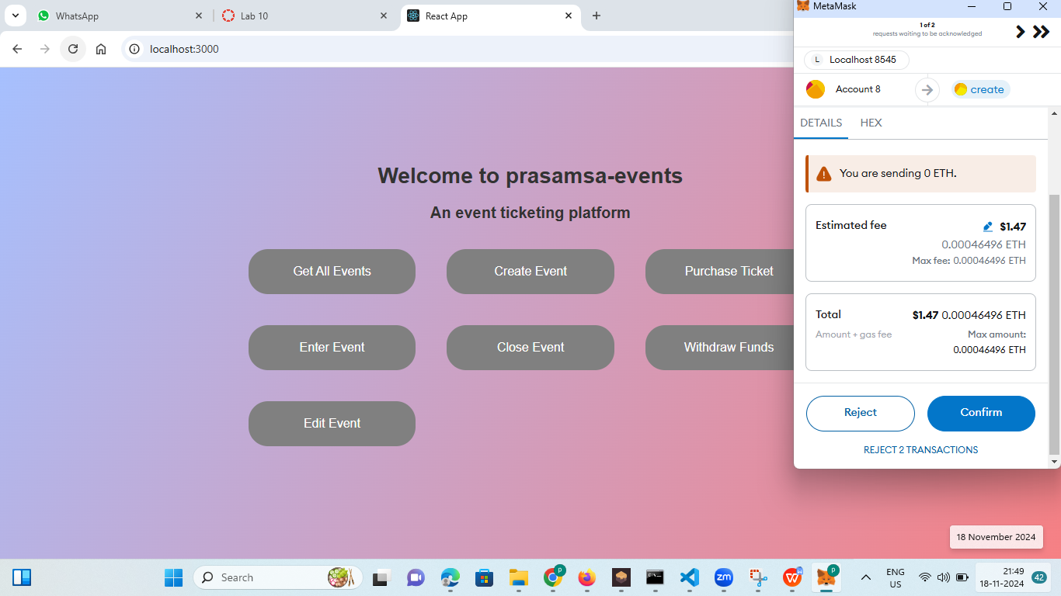

Slide 7
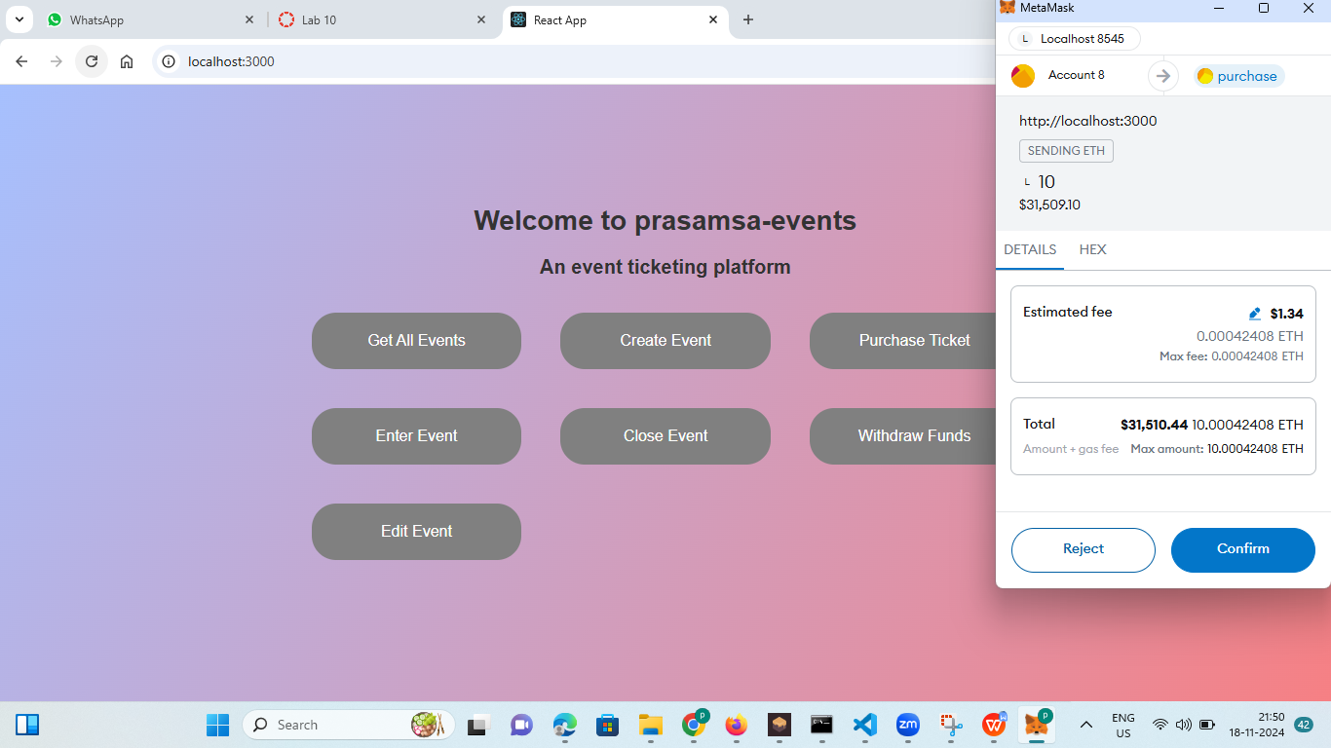

Slide 8
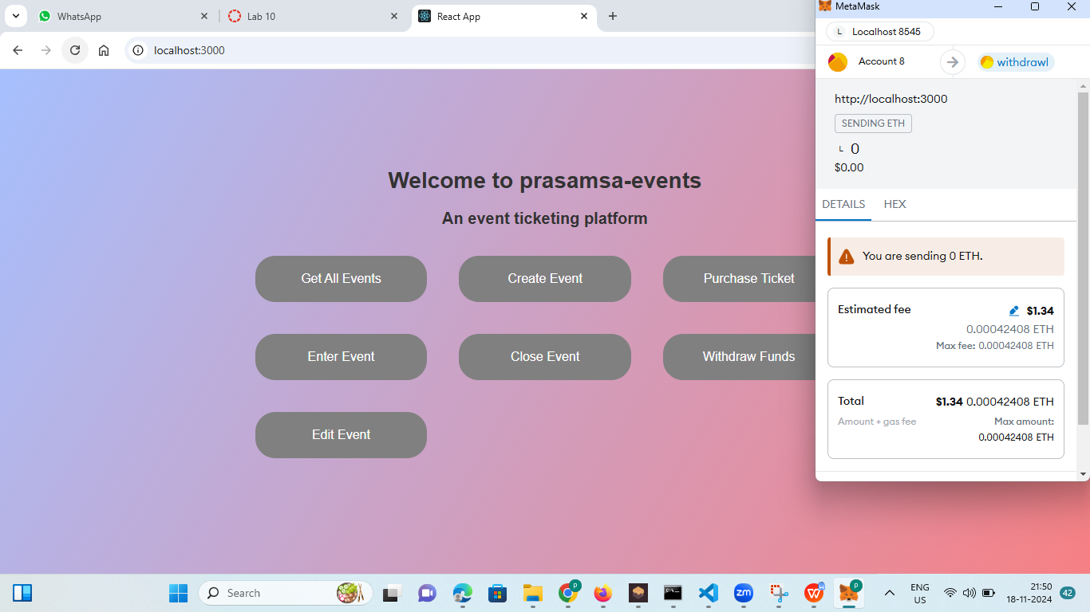

Slide 9
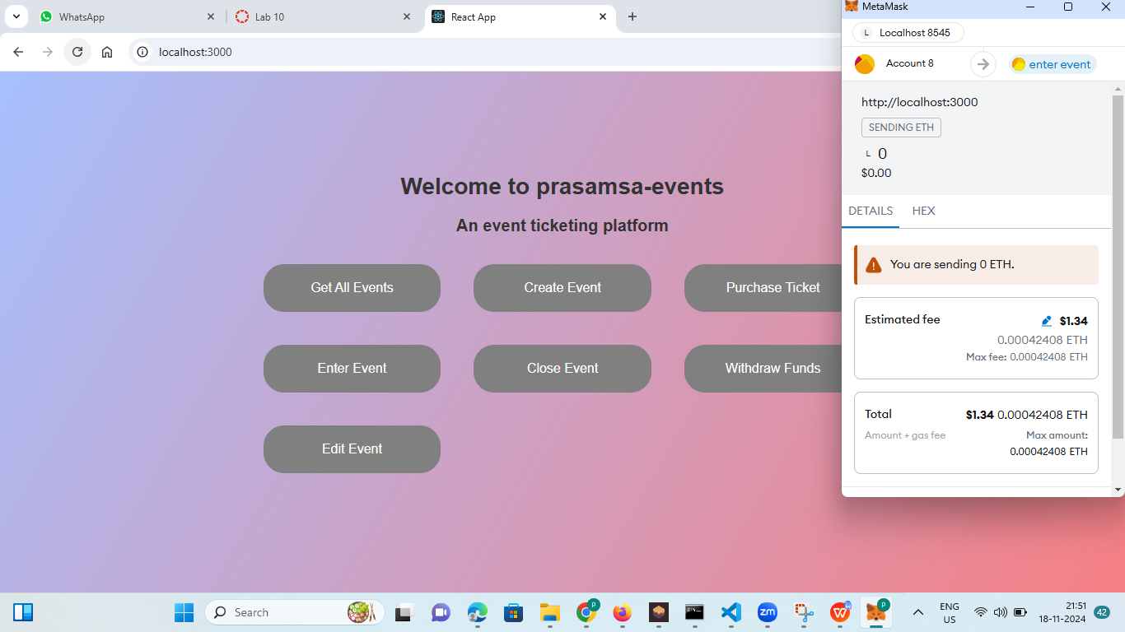

Slide 10
THANK YOU

